Slide 1
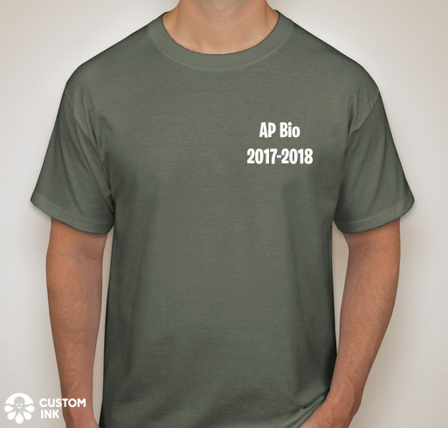
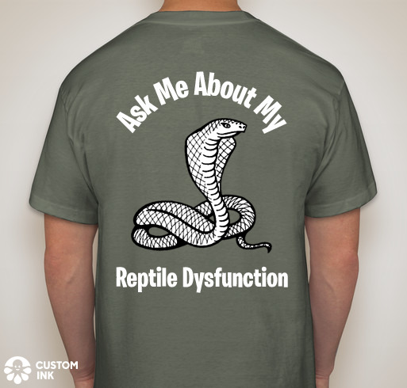
Comfort Colors ($16 each)

Slide 2
$16 Needed by 4/18
Cash
Check payable to NFHS

