Slide 2
Standard Deviation and Standard Error of the Mean

Slide 3
Standard Deviation
Standard Deviation – measure how spread out the data is from the mean
Notes:
If you repeat your sample 20 times at 95% CI, then the confidence limits around the sample means will include the true population mean 19 times.

Slide 4
Lower standard deviation:
Data is closer to the mean
Greater likelihood that the independent variable is causing the changes in the dependent variable
Higher standard deviation:
Data is more spread out from the mean
More likely factors, other than the independent variable, are influencing the dependent variable

Slide 5
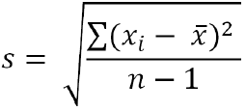
Calculating standard deviation, s
Calculate the mean (x)
Determine the difference between each data point, and the mean
Square the differences
Sum the squares
Divide by sample size (n) minus 1
Take the square root

Slide 6
Practice
4 bears were captured in Alaska. Using molecular testing, their ages were determined to be: 5, 4, 9, and 15.
Based on your sample:
What is the mean age of the bears?
What is the standard deviation? (Round to nearest tenth)

Slide 7
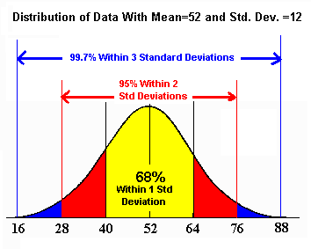

Slide 8
Calculate with 95% confidence
+/- 2 standard deviation
Example: Human body temperature
Mean = 98.25 Standard deviation = 0.73
1 SD means add 0.73 to 98.25 and subtract 0.73 from 98.25
Range = 97.52 – 98.98 This is 68% confidence level
2 SD means add 2(0.73) to 98.25 and subtract 2(0.73) from 98.25
Range = 96.79 – 99.71 This is 95% confidence level
*If we counted 10,000 people, we can confidently say 95% of them have a body temperature between 96.79 – 99.71

Slide 9
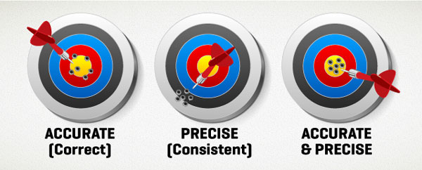
Standard Error:
Indication of how well the mean of a sample (x) estimates the true mean of a population (μ)
Measure of accuracy, if the true mean is known
Measure of precision, if true mean is not known

Slide 10
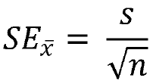
Calculating Standard Error, SE
Calculate standard deviation
Divide standard deviation by square root of sample size

Slide 11
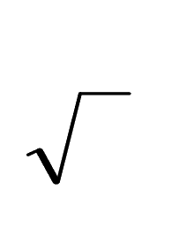
Standard Error of the Mean
SEM = standard deviation
Standard Error of the Mean – allows you to make an inference about how well your sample mean matches with the population mean
+/- 2 SEM is equivalent to 95% Confidence Interval
Ex: Students can infer with 95% confidence that the true mean for the population lies within the boundaries of the sample mean +/- 2 SEM
n = number of data points
n

Slide 12
Practice
Mean = 98.25 Standard deviation = 0.73
4 students body temperature: 98.6, 97.9, 98.3, 98.2
SEM= SD SEM= 0.73/2 = 0.365
Bars: 98.25 + 2(0.365) and 98.25 – 2(0.365)
n

Slide 13
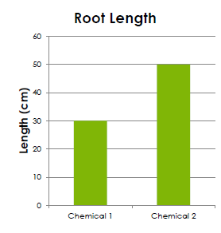
How do we use Standard Error?
Create bar graph
mean on Y-axis
sample(s) on the X-axis
chemical 1 mean = 30 cm
chemical 2 mean = 50 cm

Slide 14
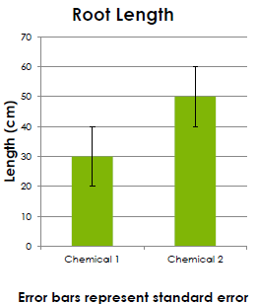
Add error bars!
± SE
Indicate in figure caption that error bars represent standard error (SE)

Slide 15
Analyze!
Look for overlap of error lines:
If they overlap: The difference is not significant
If they don’t overlap: The difference may be significant

Slide 16
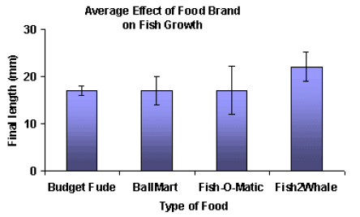
Which is a valid statement?
Fish2Whale food caused the most fish growth
Fish2Whale food caused more fish growth than did Budget Fude
✗
✓

Slide 17
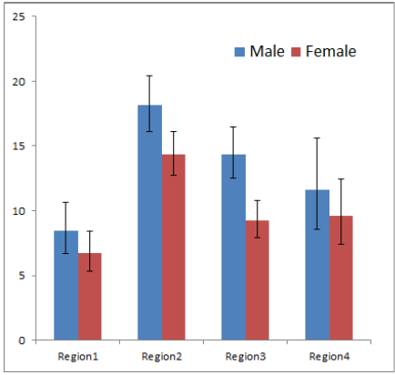
Statements:
In all four regions, more males exhibited the trait measured than did females.
More males in region 3 exhibited the measured trait than did females
✗
✓

Slide 18
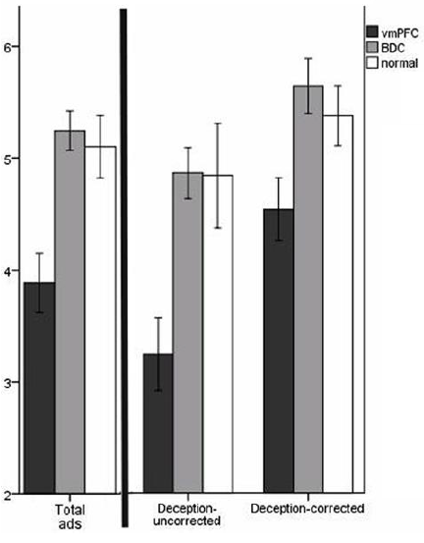
Mean belief scores for misleading ads
vmPFC = damage to ventromedial prefrontal cortex
BDC = brain damaged comparison group
Statements:
The vmPFC group identified fewer ads as misleading than did the normal group
The BDC group identified more ads as misleading than did the normal group.
# of ads identified as misleading
✓
✗

Slide 19
What you need to do now:
Part 3 Lab: Graph % change on y and molarity on x; draw a line of best fit to determine the molarity of your potato (where it crosses x)
Record your potato’s molarity in correct column of class data
Calculate mean molarity of white and sweet potatoes
Calculate standard deviation for each potato type
Calculate SEM for each potato type and create a graph comparing the means (including error bars representing 2 SEMs)
Write a conclusion as to whether sweet potatoes are indeed significantly sweeter than white potatoes. Justify your conclusion using data from your graph

