Slide 1
Restriction Mapping of Plasmids

Slide 2
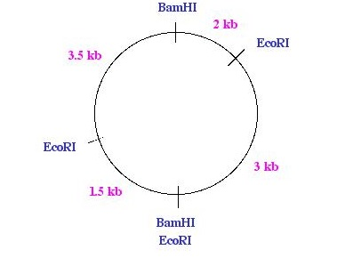
Given the restriction map for the plasmid,
show on the gel the approximate positions of the restriction fragments.
EcoR1 &
BamH1
EcoR1
BamH1
6-5-4-3-2-1

Slide 3
General Rules for Mapping Plasmids
Made sure all add up to the same total. There may be double bands!
Map the more complex plasmid first.
Look for fragments that are retained in the double digest.
Figure out where to place the remaining plasmid
*there may be multiple correct answers!!!

Slide 4
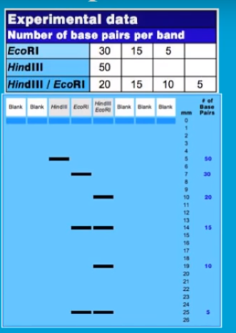

Slide 5
