Slide 1
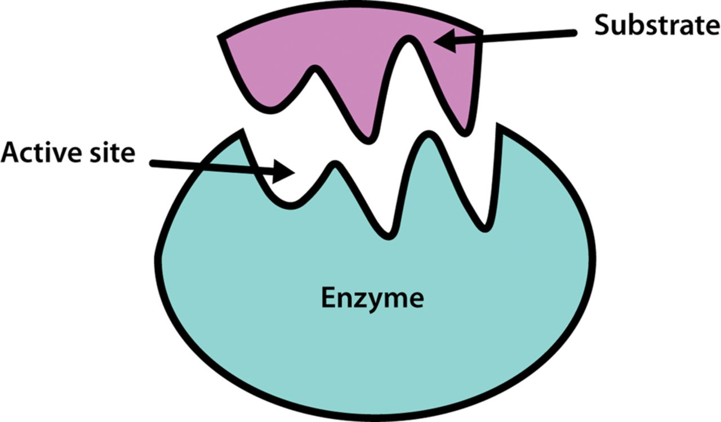
Enzymes

Slide 2
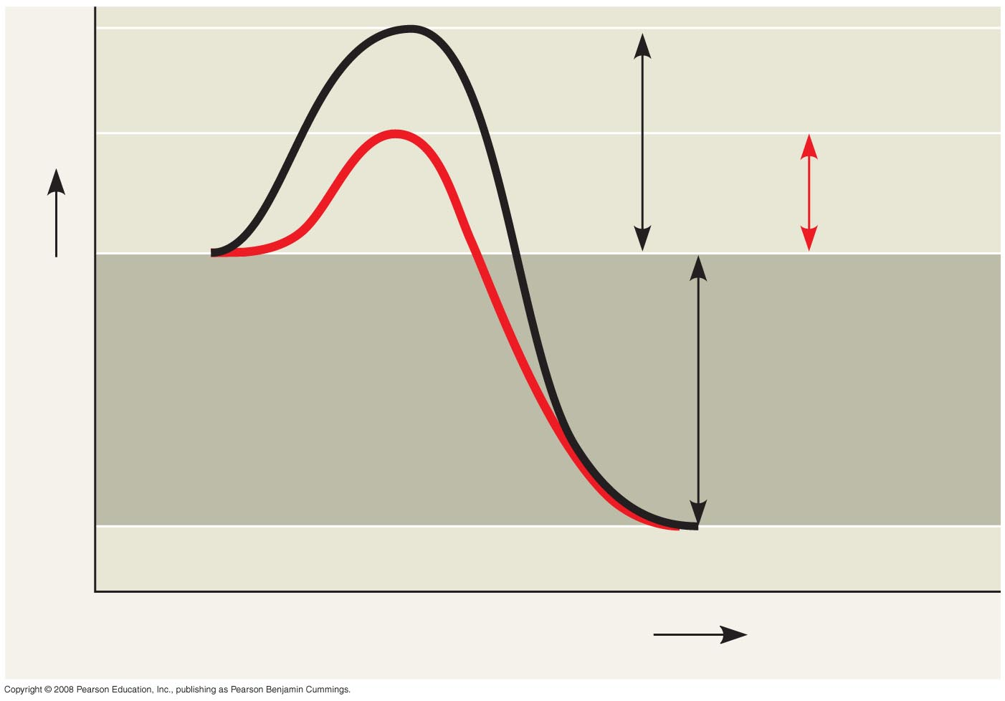
Fig. 8-UN2
Course of
reaction
without
enzyme
E_{A}
without
enzyme
E_{A} with
enzyme
is lower
Reactants
Free energy
Course of
reaction
with enzyme
∆G is unaffected
by enzyme
Products
Progress of the reaction

Slide 3
Catalysis in the Enzyme’s Active Site
In an enzymatic reaction, the substrate binds to the active site of the enzyme
The active site can lower an E_{A} barrier by
Orienting substrates correctly
Straining substrate bonds
Providing a favorable microenvironment
Covalently bonding to the substrate
Copyright © 2008 Pearson Education, Inc., publishing as Pearson Benjamin Cummings

Slide 4
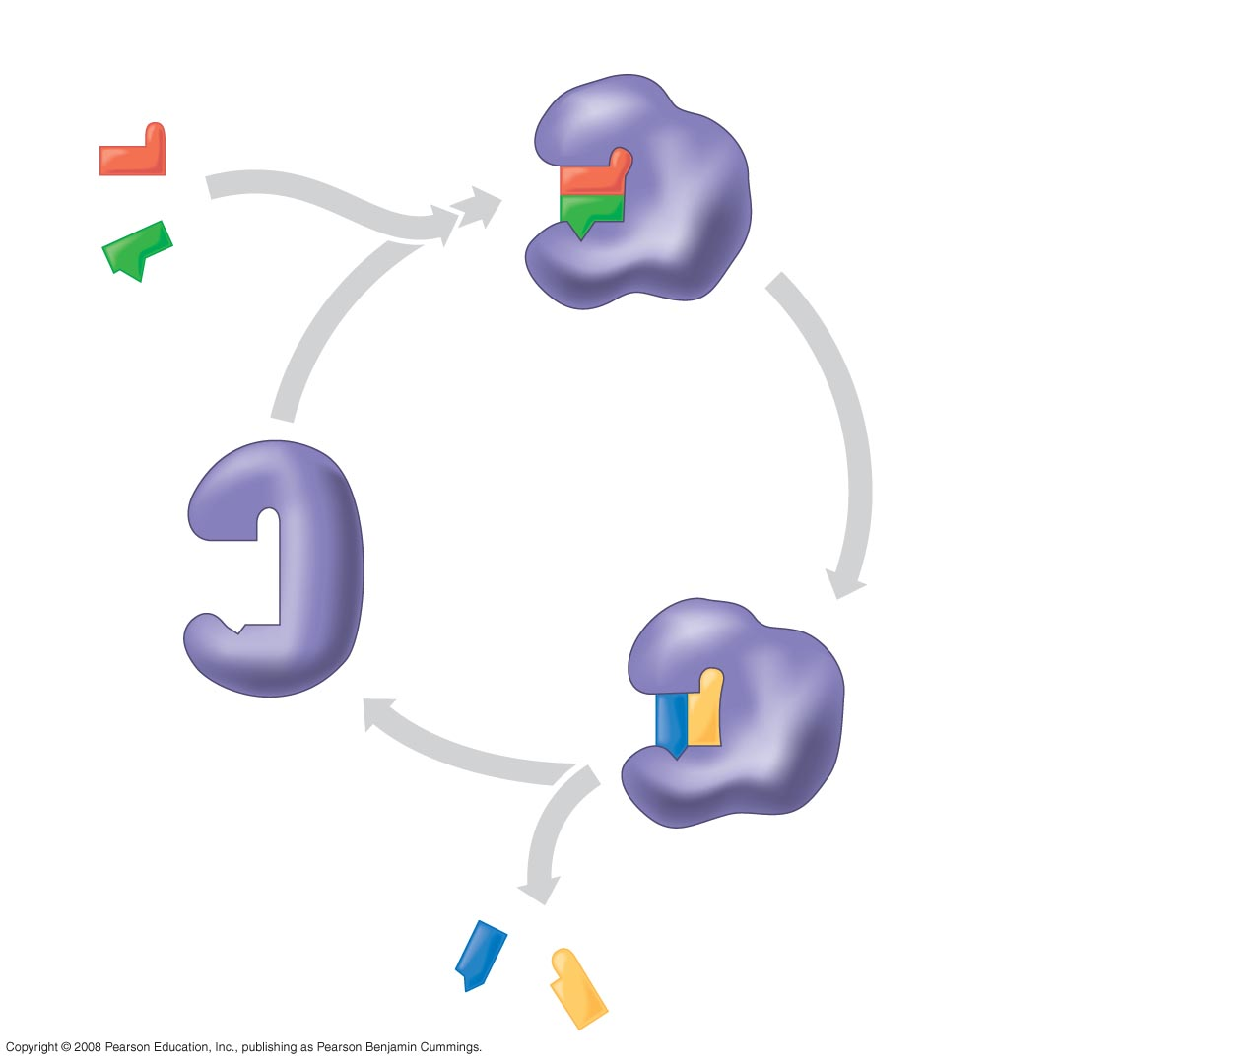
Fig. 8-17
Substrates enter active site; enzyme
changes shape such that its active site
enfolds the substrates (induced fit).
1
2
Substrates held in
active site by weak
interactions, such as
hydrogen bonds and
ionic bonds.
Substrates
Enzyme-substrate
complex
Active site can lower E_{A}
and speed up a reaction.
3
6
Active
site is
available
for two new
substrate
molecules.
Enzyme
5
Products are
released.
4
Substrates are
converted to
products.
Products
Notes:
Figure 8.17 The active site and catalytic cycle of an enzyme

Slide 5
Cofactors
Cofactors are nonprotein enzyme helpers
Cofactors may be inorganic (such as Cu²+, Fe²⁺) or organic
An organic cofactor is called a coenzyme
Coenzymes include vitamins
Copyright © 2008 Pearson Education, Inc., publishing as Pearson Benjamin Cummings

Slide 6
Enzyme Inhibitors
Competitive inhibitors bind to the active site of an enzyme, competing with the substrate
Noncompetitive inhibitors bind to another part of an enzyme, causing the enzyme to change shape and making the active site less effective
Examples of inhibitors include toxins, poisons, pesticides, and antibiotics
Copyright © 2008 Pearson Education, Inc., publishing as Pearson Benjamin Cummings

Slide 7
Allosteric Regulation of Enzymes
Allosteric regulation may either inhibit or stimulate an enzyme’s activity
Allosteric enzymes are made up of two or more units, each of which has its own active site
Allosteric regulation occurs when a regulatory molecule binds to an allosteric site and affects the protein’s function at the active sites
Copyright © 2008 Pearson Education, Inc., publishing as Pearson Benjamin Cummings

Slide 8
Allosteric Activation and Inhibition
Most are made from polypeptide subunits
Each enzyme has active and inactive forms
The binding of an activator stabilizes the active form of the enzyme
The binding of an inhibitor stabilizes the inactive form of the enzyme
Copyright © 2008 Pearson Education, Inc., publishing as Pearson Benjamin Cummings

Slide 9
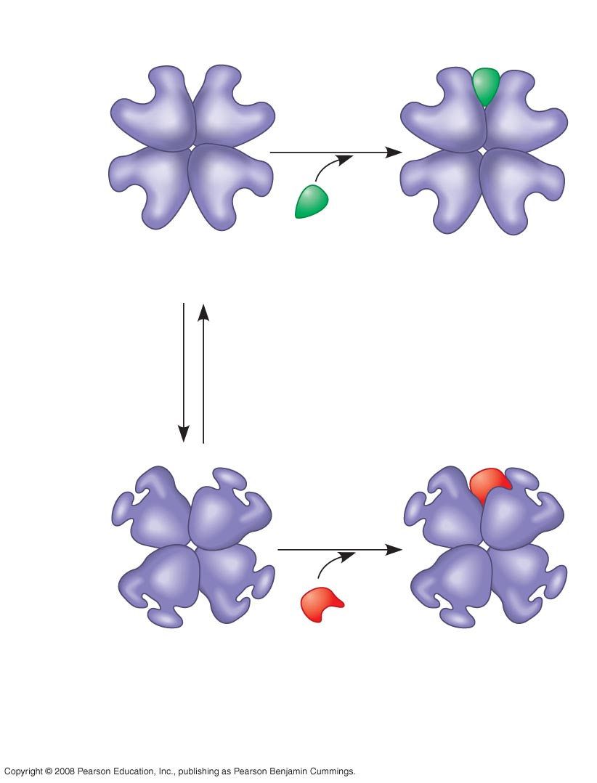
Fig. 8-20a
Allosteric enzyme
with four subunits
Active site
(one of four)
Regulatory
site (one
of four)
Activator
Active form
Stabilized active form
Oscillation
Non-
functional
active
site
Inhibitor
Stabilized inactive
form
Inactive form
(a) Allosteric activators and inhibitors
Notes:
Figure 8.20a Allosteric regulation of enzyme activity

Slide 10
Cooperativity is a form of allosteric regulation that can amplify enzyme activity
In cooperativity, binding by a substrate to one active site stabilizes favorable conformational changes at all other subunits
Increases the likelihood substrate will bind to the other active sites
Copyright © 2008 Pearson Education, Inc., publishing as Pearson Benjamin Cummings

Slide 11
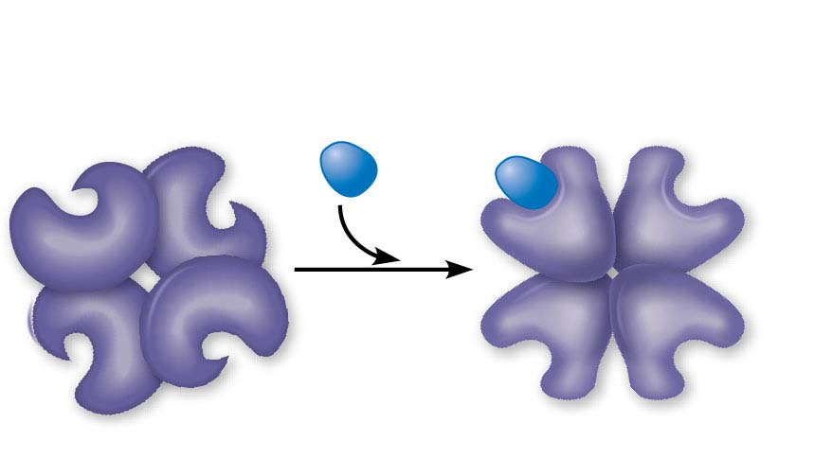
Figure 6.18-2
(b) Cooperativity: another type of allosteric activation
Substrate
Inactive form
Stabilized active form
© 2016 Pearson Education, Inc.
Notes:
Figure 6.18-2 Allosteric regulation of enzyme activity (part 2: cooperativity)

Slide 12
Feedback Inhibition
In feedback inhibition, the end product of a metabolic pathway shuts down the pathway
Feedback inhibition prevents a cell from wasting chemical resources by synthesizing more product than is needed

Slide 13
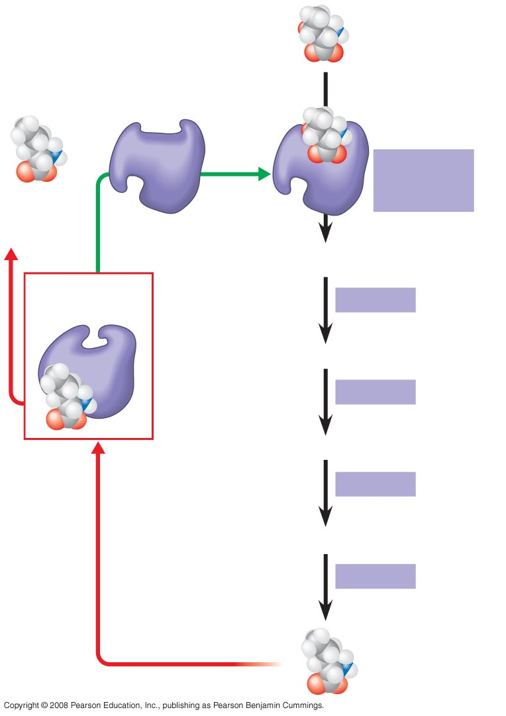
Fig. 8-22
Initial substrate
(threonine)
Active site
available
Threonine
in active site
Enzyme 1
(threonine
deaminase)
Isoleucine
used up by
cell
Intermediate A
Feedback
inhibition
Enzyme 2
Active site of
enzyme 1 no
longer binds
threonine;
pathway is
switched off.
Intermediate B
Enzyme 3
Isoleucine
binds to
allosteric
site
Intermediate C
Enzyme 4
Intermediate D
Enzyme 5
End product
(isoleucine)
Notes:
Figure 8.22 Feedback inhibition in isoleucine synthesis

Slide 14
Specific Localization of Enzymes Within the Cell
Structures within the cell help bring order to metabolic pathways
Some enzymes act as structural components of membranes
In eukaryotic cells, some enzymes reside in specific organelles; for example, enzymes for cellular respiration are located in mitochondria
Copyright © 2008 Pearson Education, Inc., publishing as Pearson Benjamin Cummings

