Slide 1
6
An Introduction to Metabolism

Slide 2
Figure 6.UN01
Metabolism is the totality of an organism’s chemical reactions
A metabolic pathway begins with a specific molecule and ends with a product
Enzyme 1
Enzyme 2
Enzyme 3
A
B
C
D
Reaction 1
Reaction 2
Reaction 3
Starting
molecule
Product
Each step is catalyzed by a specific enzyme
© 2016 Pearson Education, Inc.
Notes:
Figure 6.UN01 In-text figure, metabolic pathway, p. 122

Slide 3
Catabolic pathways release energy by breaking down complex molecules into simpler compounds
Ex: cellular respiration
Anabolic pathways consume energy to build complex molecules from simpler ones
Ex: making protein from amino acids
Notes:
3

Slide 4
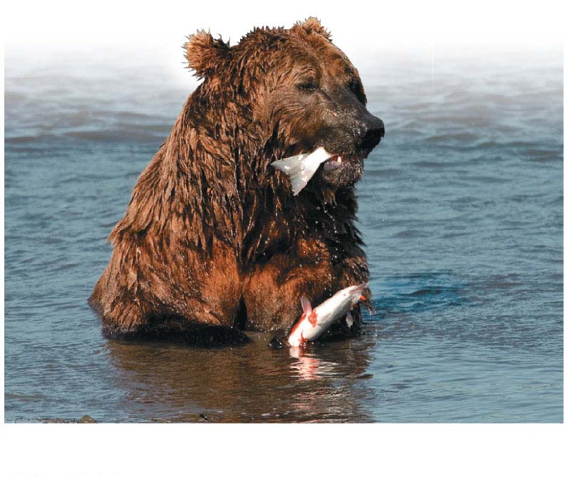
The First Law of Thermodynamics
Energy can be transferred and or transformed, but it cannot be created or destroyed
Notes:
4

Slide 5
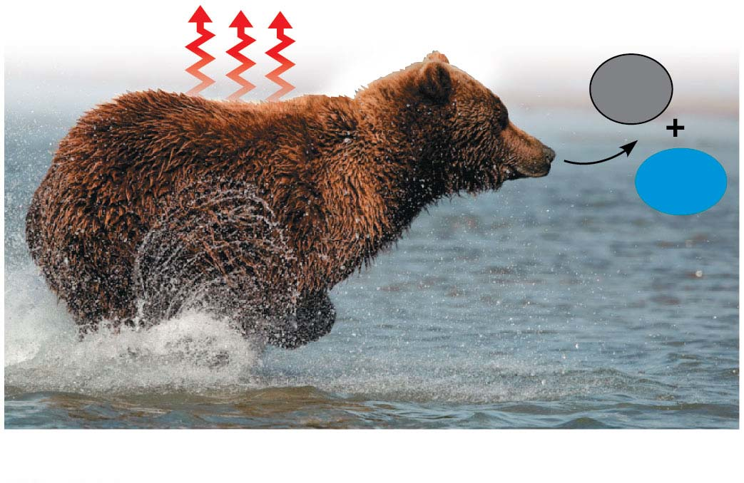
The Second Law of Thermodynamics
Every energy transfer or transformation increases the entropy of the universe
During every energy transfer or transformation, some energy is lost as heat
Entropy is a measure of disorder, or randomness
Heat
CO₂
H₂O
Notes:
5

Slide 6
Free-Energy
free energy (G) is energy that can do work when temperature and pressure are uniform, as in a living cell
The free-energy change of a reaction tells us whether or not the reaction occurs spontaneously ∆G = G_{final state} – G_{initial state}
Notes:
6

Slide 7
The change in free energy (∆G) during a process is related to the change in enthalpy, or change in total energy (∆H), change in entropy (∆S), and temperature in Kelvin (T):
∆G = ∆H – T∆S
Only processes with a negative ∆G are spontaneous
Spontaneous processes can be harnessed to perform work
Copyright © 2008 Pearson Education, Inc., publishing as Pearson Benjamin Cummings

Slide 8
Exergonic and Endergonic Reactions in Metabolism
An exergonic reaction proceeds with a net release of free energy and is spontaneous; ∆G is negative
The magnitude of ∆G represents the maximum amount of work the reaction can perform
Notes:
8

Slide 9
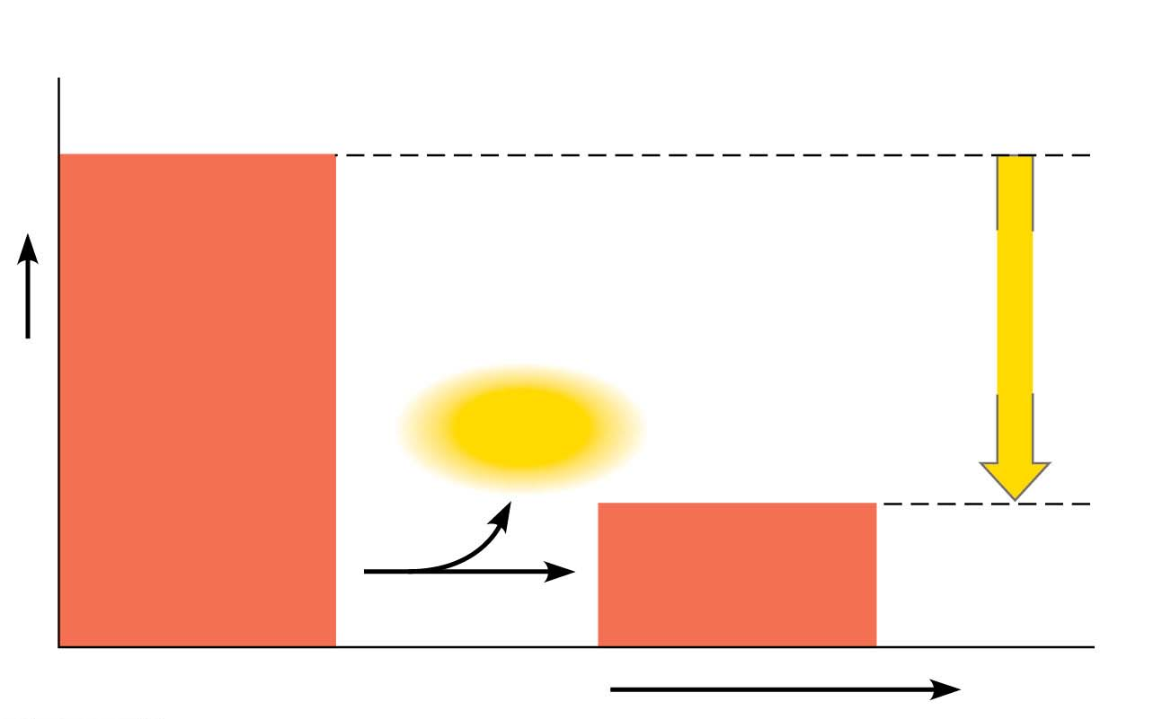
Figure 6.6-1
(a) Exergonic reaction: energy released, spontaneous
Reactants
Amount of
energy
released
(ΔG < 0)
Free energy
Energy
Products
Progress of the reaction
© 2016 Pearson Education, Inc.
Notes:
Figure 6.6-1 Free energy changes (∆G) in exergonic and endergonic reactions (part 1: exergonic)

Slide 10
An endergonic reaction absorbs free energy from its surroundings and is nonspontaneous; ∆G is positive
The magnitude of ∆G is the quantity of energy required to drive the reaction
Notes:
10

Slide 11
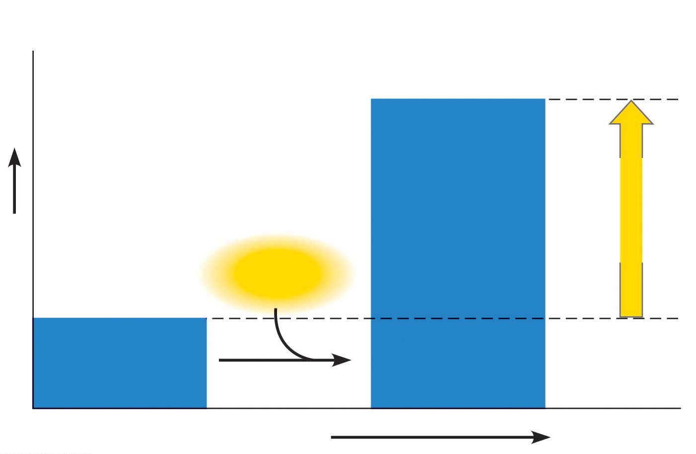
Figure 6.6-2
(b) Endergonic reaction: energy required, nonspontaneous
Products
Amount of
energy
required
(ΔG > 0)
Free energy
Energy
Reactants
Progress of the reaction
© 2016 Pearson Education, Inc.
Notes:
Figure 6.6-2 Free energy changes (∆G) in exergonic and endergonic reactions (part 2: endergonic)

Slide 12
A cell does three main kinds of work
Chemical
Transport
Mechanical
To do work, cells manage energy resources by energy coupling, the use of an exergonic process to drive an endergonic one
Most energy coupling in cells is mediated by ATP
Notes:
12

Slide 13
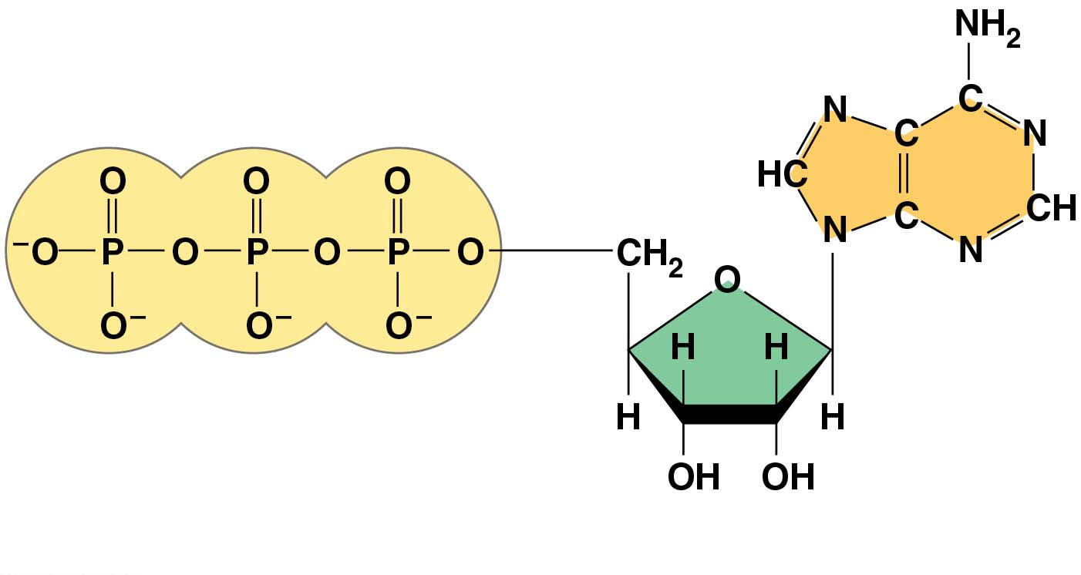
Figure 6.8-1
Adenine
Triphosphate group
(3 phosphate groups)
Ribose
(a) The structure of ATP
© 2016 Pearson Education, Inc.
Notes:
Figure 6.8-1 The structure and hydrolysis of adenosine triphosphate (ATP) (part 1: structure)

Slide 14
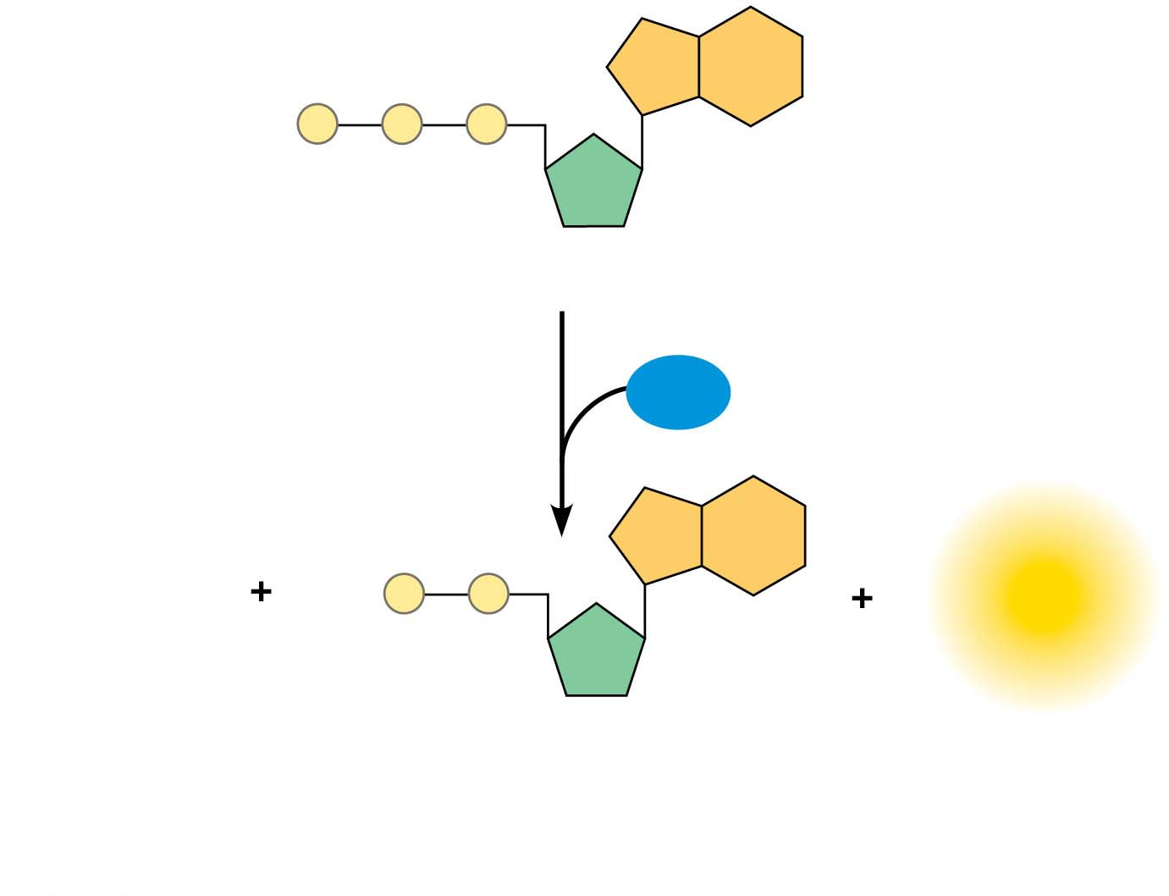
Figure 6.8-2
P
P
P
Adenosine triphosphate (ATP)
H₂O
P
P
P
Energy
i
Inorganic
Adenosine diphosphate (ADP)
phosphate
(b) The hydrolysis of ATP
© 2016 Pearson Education, Inc.
Notes:
Figure 6.8-2 The structure and hydrolysis of adenosine triphosphate (ATP) (part 2: hydrolysis)

Slide 15
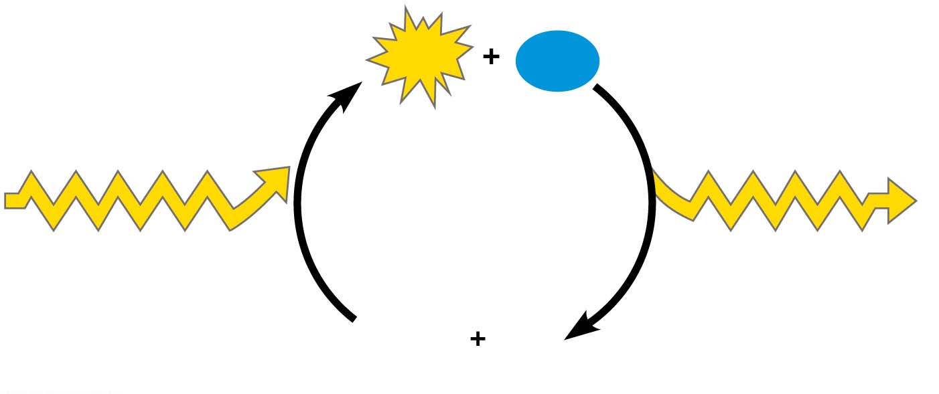
Figure 6.11
ATP
H₂O
Energy from
catabolism (exergonic,
energy-releasing
processes)
Energy for cellular
work (endergonic,
energy-consuming
processes)
ADP
P
i
© 2016 Pearson Education, Inc.
Notes:
Figure 6.11 The ATP cycle

