Slide 1
Cell Communication

Slide 2
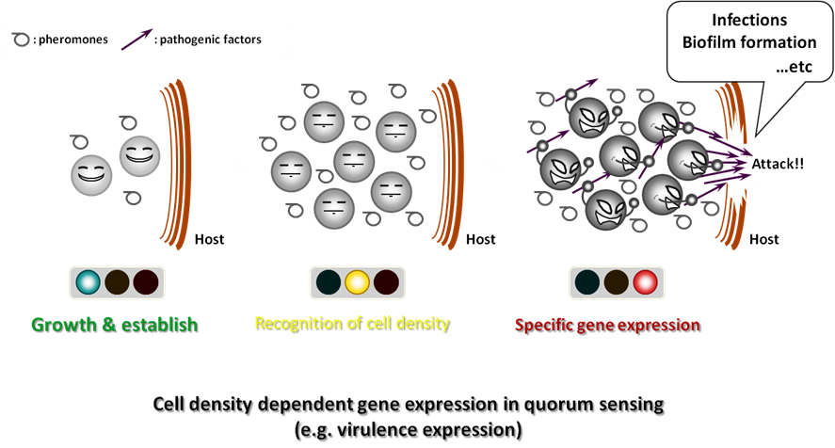
Evolutionary Process From Prokaryotes
Bacteria communicate and cooperate through quorum sensing to tell other bacteria how crowded the environment is

Slide 3
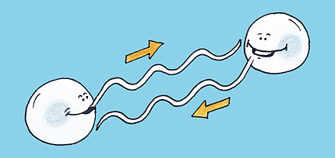
Local Signaling
Cells in a multicellular organism communicate by chemical messengers
In one type of local signaling, cells communicate by direct contact, or cell-cell recognition
Copyright © 2008 Pearson Education, Inc., publishing as Pearson Benjamin Cummings

Slide 4
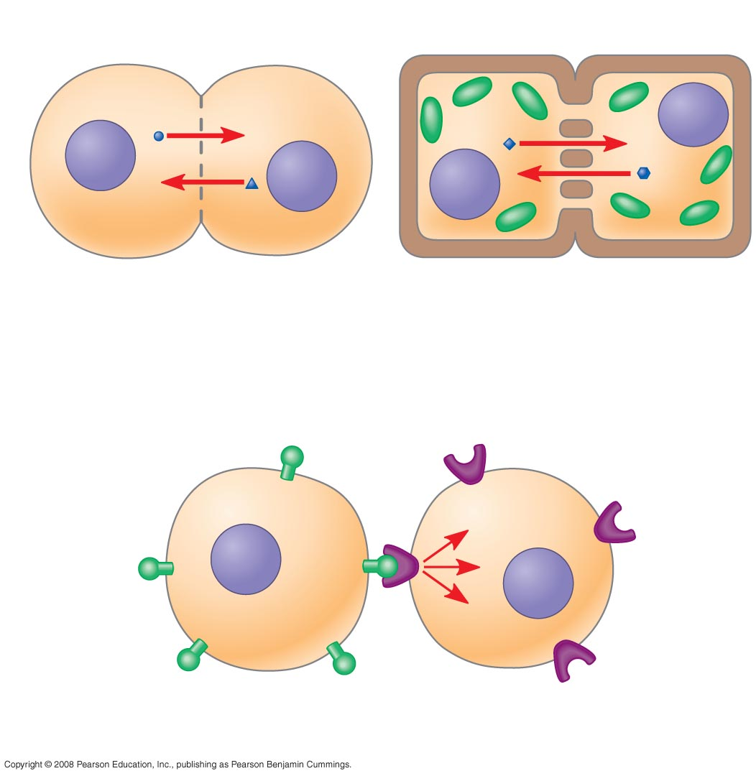
Plasma membranes
Gap junctions
between animal cells
Plasmodesmata
between plant cells
(a) Cell junctions
Glycolipds and glycoproteins
in plasma membrane!
(b) Cell-cell recognition
Notes:
Figure 11.4 Communication by direct contact between cells

Slide 5
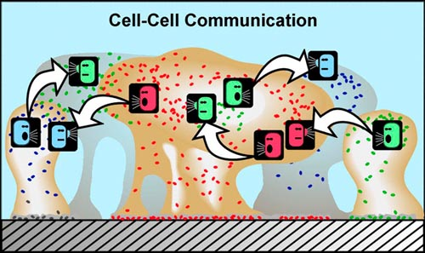
Local Signaling
In many other cases of local signaling, messenger molecules are secreted by a signaling cell
These local regulators travel only short distances
Ex: growth factors, stimulates nearby cells to grow and divide
This is called paracrine signaling in animal cells
Notes:
5

Slide 6
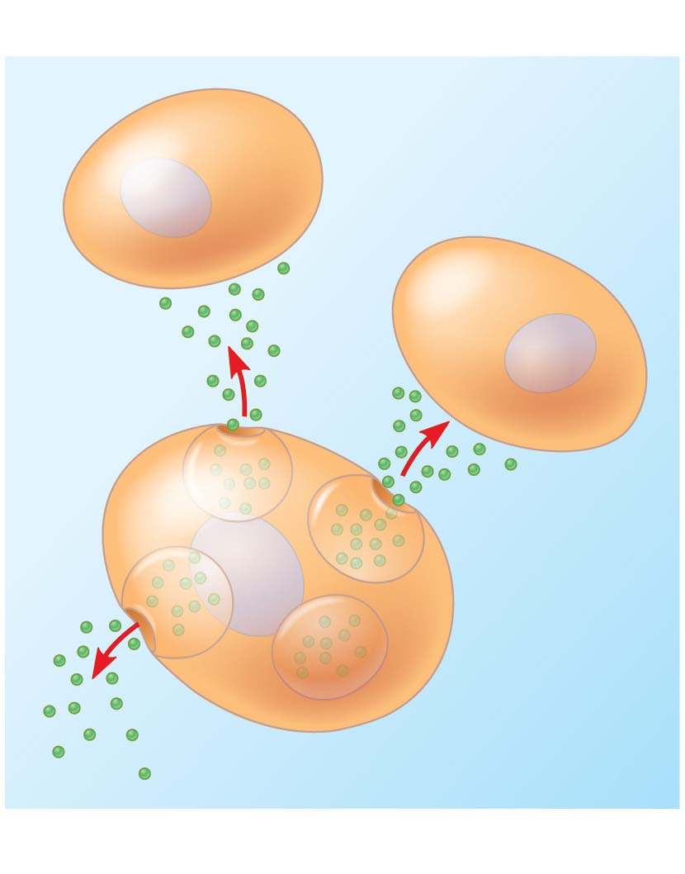
Figure 5.19-1
Local signaling
Target cells
Secreting
cell
Secretory
vesicles
Local regulator
(a) Paracrine signaling
Notes:
Figure 5.19-1 Local and long-distance cell signaling by secreted molecules in animals (part 1: local signaling, paracrine)

Slide 7
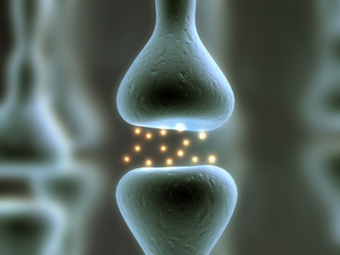
Local Signaling
Another more specialized type of local signaling occurs in the animal nervous system
This is called synaptic signaling
Notes:
7

Slide 8
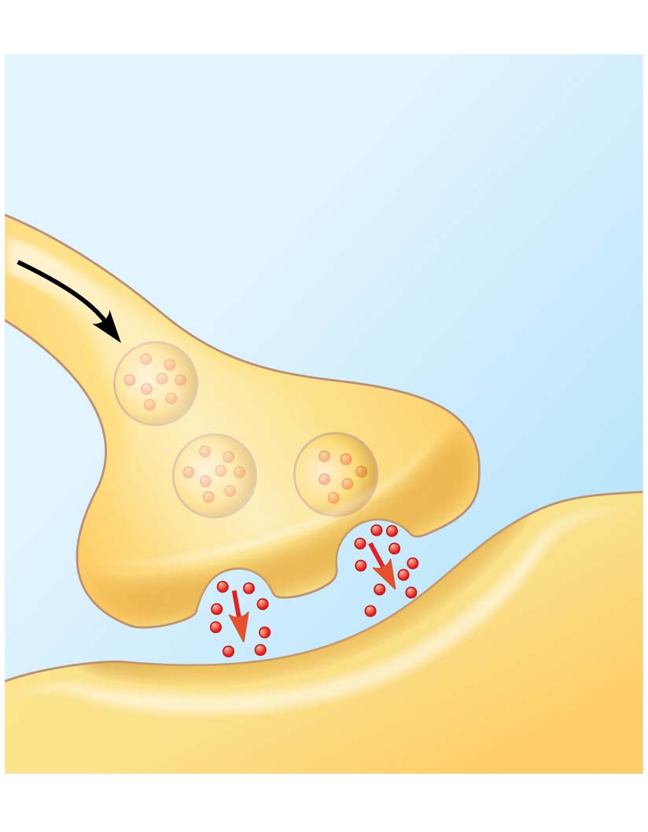
Figure 5.19-2
Local signaling
Electrical signal triggers
release of neurotransmitter.
Neurotransmitter
diffuses across
synapse.
Target cell
(b) Synaptic signaling
Notes:
Figure 5.19-2 Local and long-distance cell signaling by secreted molecules in animals (part 2: local signaling, synaptic)

Slide 9
Long Distance Signaling
In long-distance signaling, plants and animals use chemicals called hormones
In hormonal signaling in animals (called endocrine signaling), specialized cells release hormone molecules that travel via the circulatory system
Hormones vary widely in size and shape (proteins!)
Notes:
9

Slide 10
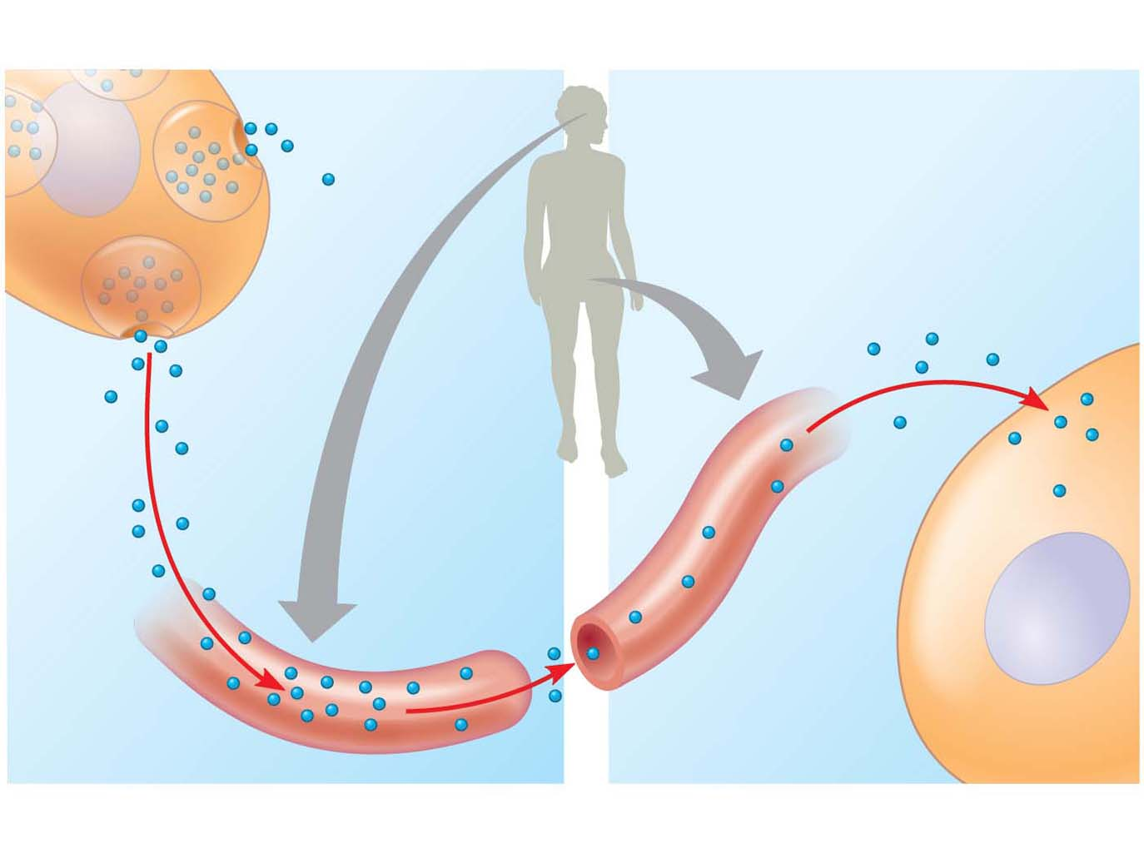
Figure 5.19-3
Long-distance signaling
Endocrine cell
Target cell
specifically
binds
hormone.
Hormone
travels in
bloodstream.
Blood
vessel
(c) Endocrine (hormonal) signaling
Notes:
Figure 5.19-3 Local and long-distance cell signaling by secreted molecules in animals (part 3: long distance signaling, endocrine)

Slide 11
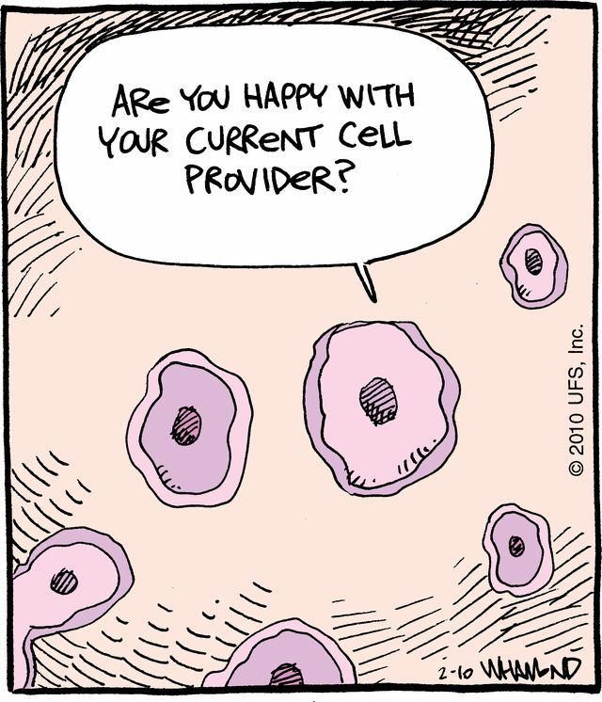
The Three Stages of Cell Signaling: A Preview
Cells receiving signals undergo three processes:
Reception
Transduction
Response
Notes:
11

Slide 12
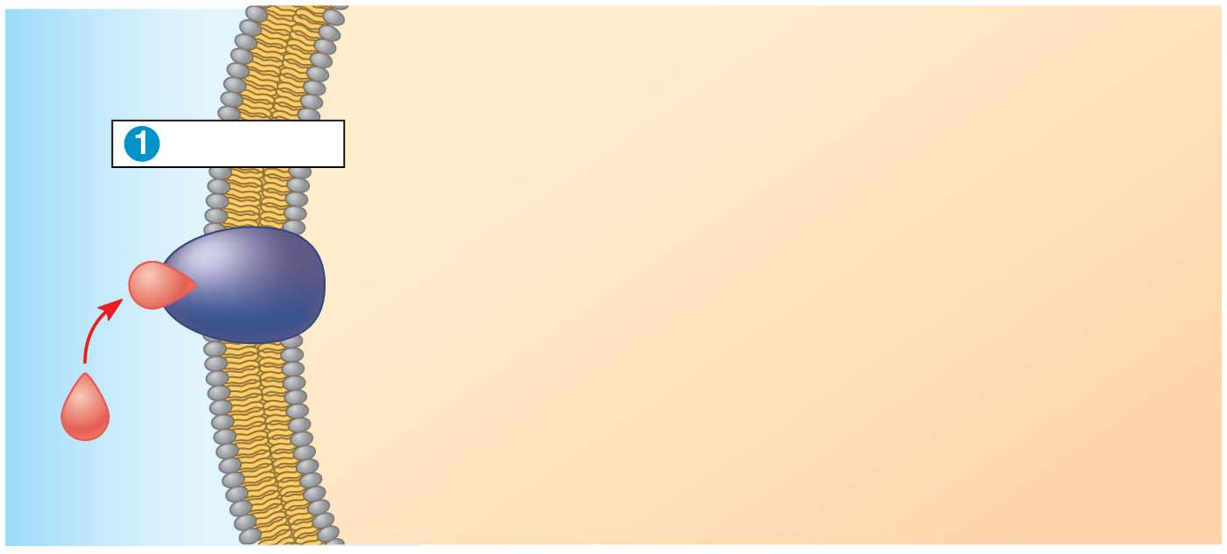
Figure 5.20-s1
EXTRA-
CELLULAR
FLUID
CYTOPLASM
Plasma membrane
Reception
Receptor
Signaling
molecule
Notes:
Figure 5.20-s1 Overview of cell signaling (step 1)

Slide 13
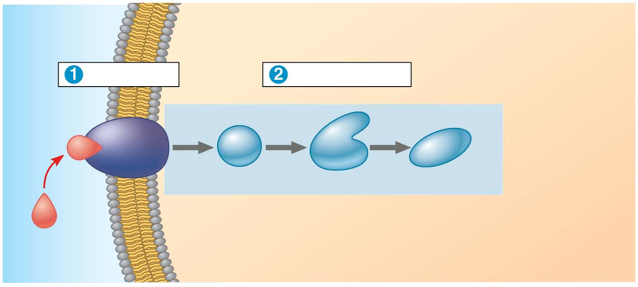
Figure 5.20-s2
EXTRA-
CELLULAR
FLUID
CYTOPLASM
Plasma membrane
Reception
Transduction
Receptor
1
2
3
Relay molecules
Signaling
molecule
Notes:
Figure 5.20-s2 Overview of cell signaling (step 2)

Slide 14
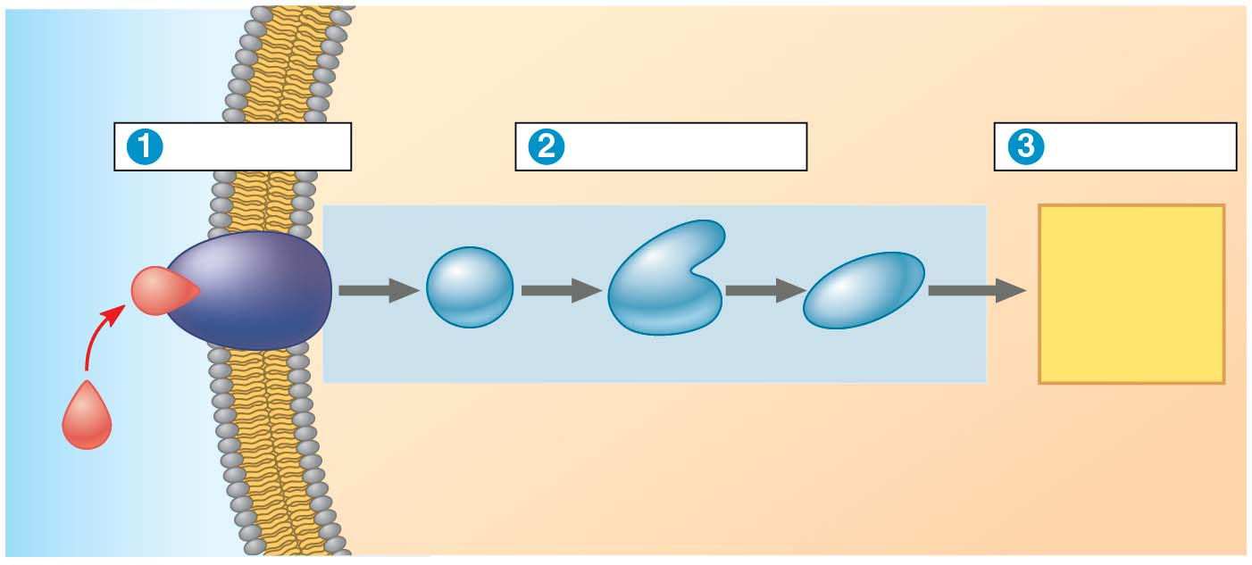
Figure 5.20-s3
EXTRA-
CELLULAR
FLUID
CYTOPLASM
Plasma membrane
Reception
Transduction
Response
Receptor
1
2
3
Activation
Relay molecules
Signaling
molecule
Notes:
Figure 5.20-s3 Overview of cell signaling (step 3)

Slide 15
Reception
The binding between a signal molecule (ligand) and receptor is highly specific; are usually large and water-soluble
A shape change in a receptor is often the initial transduction of the signal
Most signal receptors are plasma membrane proteins
Copyright © 2008 Pearson Education, Inc., publishing as Pearson Benjamin Cummings

Slide 16
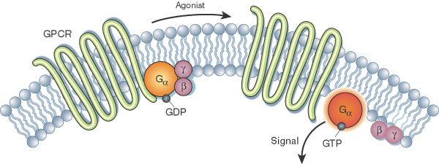
G Protein-Coupled Receptors
A plasma membrane receptor that works with the help of a G protein
The G protein acts as an on/off switch: If GDP is bound to the G protein, the G protein is inactive
Copyright © 2008 Pearson Education, Inc., publishing as Pearson Benjamin Cummings

Slide 17
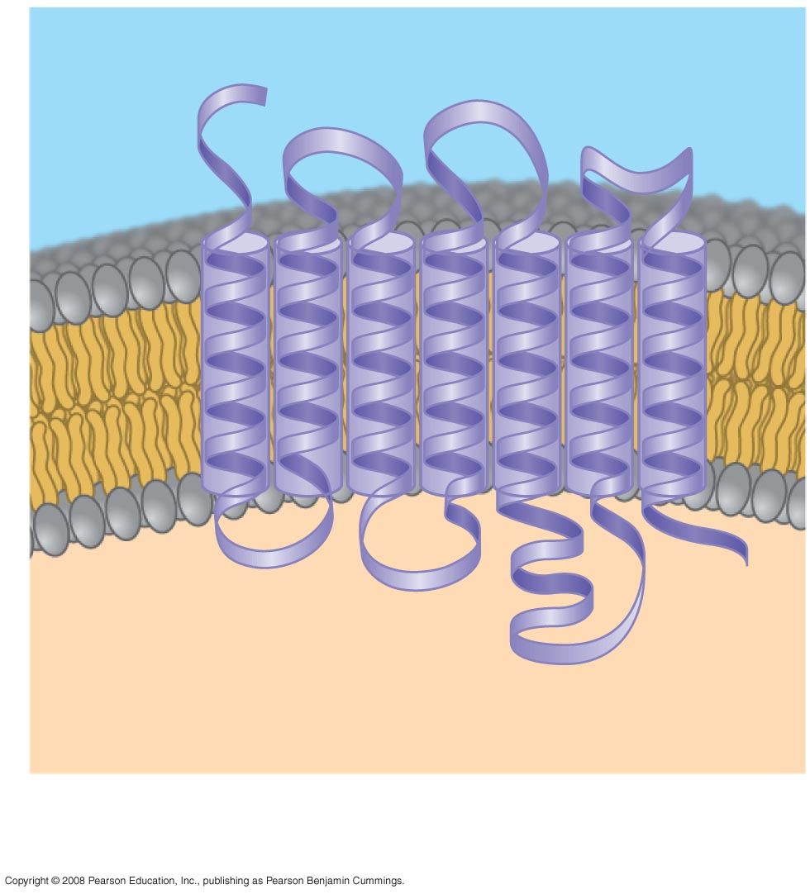
Fig. 11-7a
Signaling-molecule binding site
Segment that
interacts with
G proteins
G protein-coupled receptor
Notes:
Figure 11.7 Membrane receptors—G protein-coupled receptors, part 1

Slide 18
G Protein-Coupled Receptors
signaling molecule binds to receptor
the receptor is activated and changes shape
The receptor then binds an inactive G protein, causing a GTP to displace the GDP. This activates the G protein.
The activated G protein leaves the receptor and binds to an enzyme in the membrane, activating the enzyme
G protein hydrolyses GTP to GDP and leaves the enzyme= inactive state

Slide 19
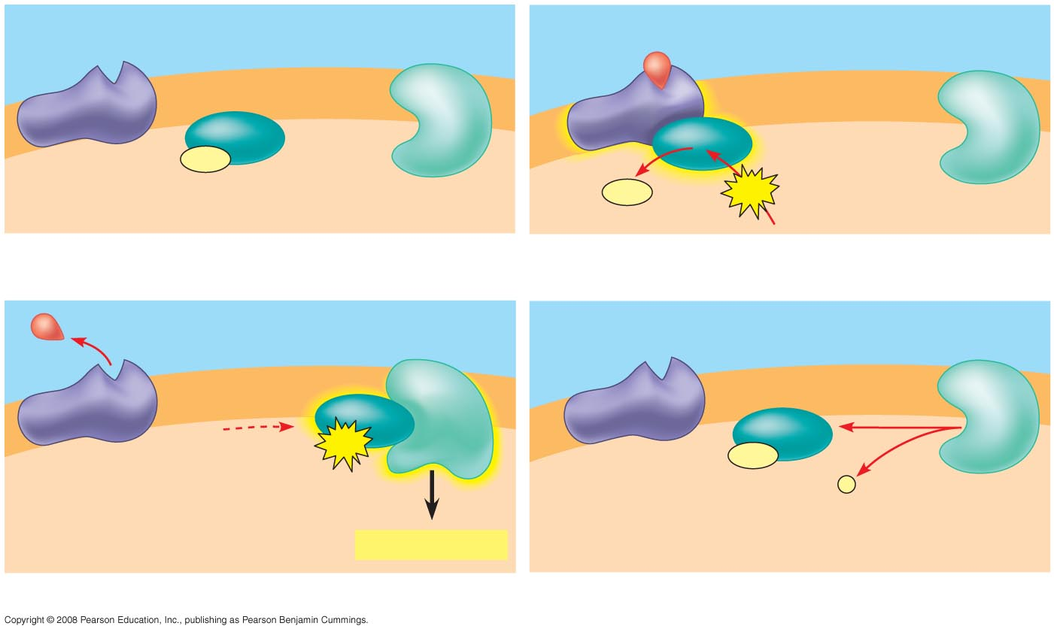
Fig. 11-7b
G protein-coupled
receptor
Plasma
membrane
Signaling molecule
Inactive
enzyme
Activated
receptor
GDP
G protein
(inactive)
Enzyme
GDP
GTP
CYTOPLASM
1
2
Activated
enzyme
GTP
GDP
P
i
Cellular response
3
4
Notes:
Figure 11.7 Membrane receptors—G protein-coupled receptors, part 2

Slide 20
Ligand-gated ion channel
A plasma membrane receptor acts as a “gate” for ions when the receptor changes shape
When a signal molecule binds as a ligand to the receptor, the gate allows specific ions, such as Na⁺ or Ca²⁺, through a channel in the receptor
Ligand-gated ion channels are very important in the nervous system
The diffusion of ions through open channels may trigger an electric signal
When the ligand dissociates from the receptor, the gate closes
Notes:
20

Slide 21
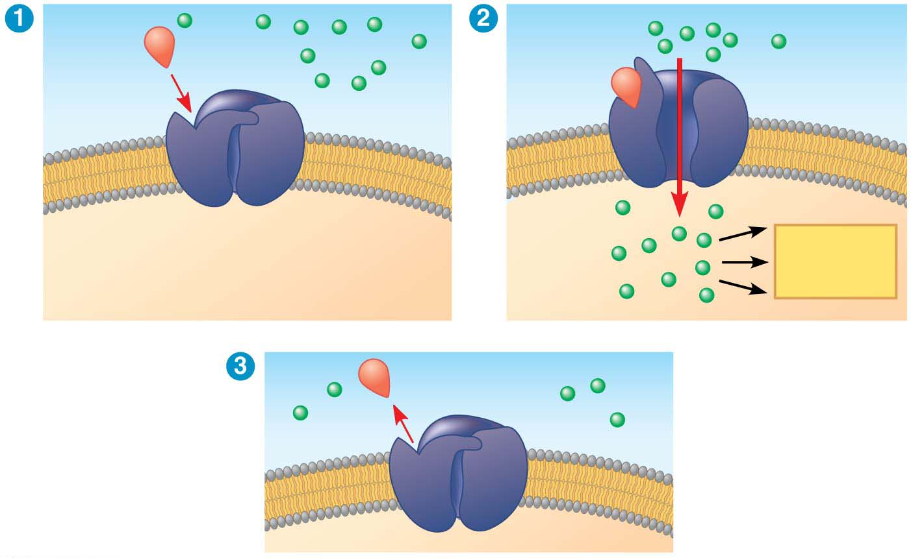
Figure 5.22-s3
Gate
closed
Gate open
Ions
Signaling
molecule
(ligand)
Cellular
response
Ligand-gated
ion channel receptor
Plasma
membrane
Gate closed
Notes:
Figure 5.22-s3 Ion channel receptor (step 3)

Slide 22
Intracellular Receptors
Intracellular receptor proteins are found in the cytosol or nucleus of target cells
Small or hydrophobic chemical messengers can readily cross the membrane and activate receptors
Examples of hydrophobic messengers are the steroid and thyroid hormones of animals and nitric oxide (NO) in both plants and animals
Notes:
22

Slide 23
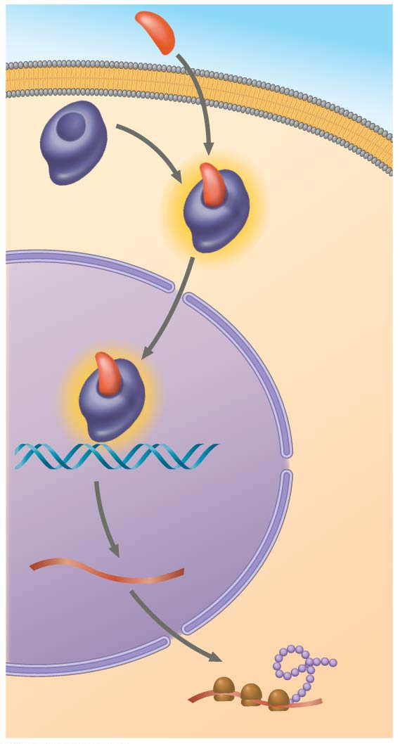
Hormone
(aldosterone)
EXTRA-
CELLULAR
FLUID
1. Hormone secreted into bloodstream
Plasma
membrane
Receptor
protein
2. Certain cells have cytoplasmic receptors
that bind to the hormone,
activating the receptor protein
Hormone-
receptor
complex
DNA
mRNA
3. The active form of the receptor enters
the nucleus, acts as a transcription factor,
and activates genes that
New
protein
NUCLEUS
CYTOPLASM
Notes:
Figure 5.23 Steroid hormone interacting with an intracellular receptor

Slide 24
Transduction by Cascades of Molecular Interactions
Signal transduction usually involves multiple steps
Multistep pathways can amplify a signal: A few molecules can produce a large cellular response
Multistep pathways provide more opportunities for coordination and regulation of the cellular response than simpler systems do
Notes:
24

Slide 25
Protein Phosphorylation and Dephosphorylation
Protein kinases transfer phosphates from ATP to protein, a process called phosphorylation
A signaling pathway involving phosphorylation and dephosphorylation can be referred to as a phosphorylation cascade
The addition of phosphate groups often changes the form of a protein from inactive to active
Notes:
25

Slide 26
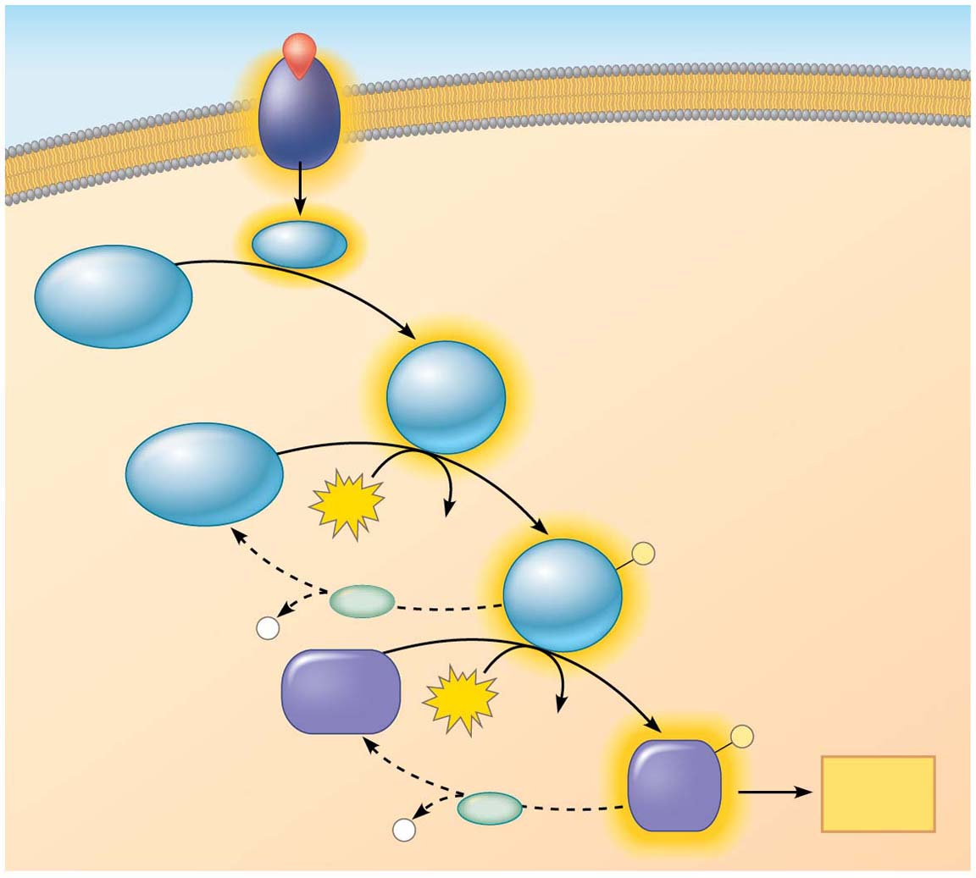
Figure 5.24
Signaling molecule
Activated relay molecule
Receptor
Inactive
protein
kinase 1
Active
protein
kinase 1
Inactive
protein
kinase 2
Phosphorylation cascade
ATP
ADP
P
Active
protein
kinase 2
PP
P
i
Inactive
protein
ATP
ADP
P
Active
protein
Cellular
response
P
PP
i
Notes:
Figure 5.24 A phosphorylation cascade

Slide 27
Protein phosphatases remove the phosphates from proteins, a process called dephosphorylation
Phosphatases provide a mechanism for turning off the signal transduction pathway
They also make protein kinases available for reuse, enabling the cell to respond to the signal again
Notes:
27

Slide 28
Small Molecules and Ions as Second Messengers
The ligand that binds to the receptor is a pathway’s “first messenger”
Second messengers are small, nonprotein, water-soluble molecules or ions that spread throughout a cell by diffusion
Cyclic AMP and calcium ions are common second messengers
Notes:
28

Slide 29
Cyclic AMP (cAMP) is one of the most widely used second messengers
Adenylyl cyclase, an enzyme in the plasma membrane, rapidly converts ATP to cAMP in response to a number of extracellular signals
The immediate effect of cAMP is usually the activation of protein kinase A, which then phosphorylates a variety of other proteins
Notes:
29

Slide 30
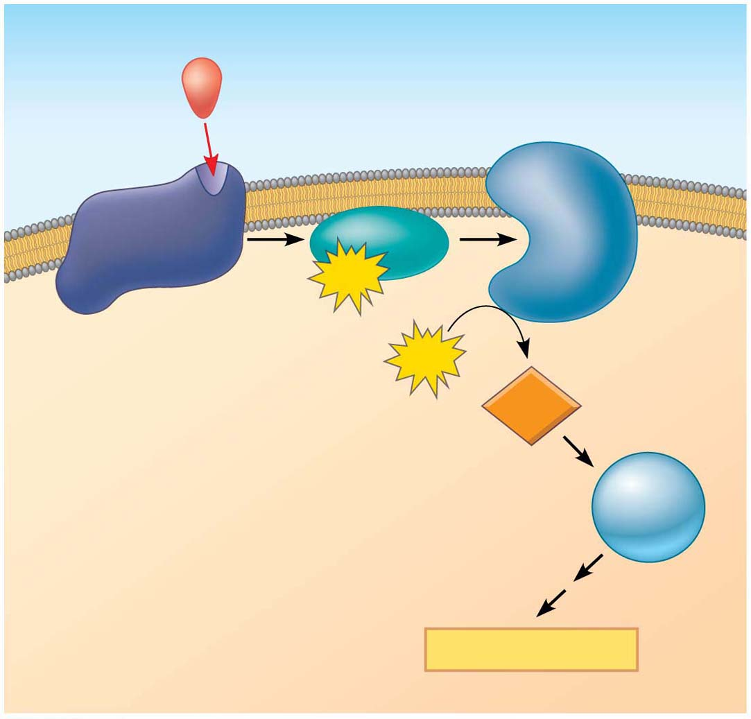
Figure 5.25
First messenger
(signaling molecule
such as epinephrine)
Adenylyl
cyclase
G protein
GTP
G protein-coupled
receptor
ATP
cAMP
Second
messenger
Protein
kinase A
Cellular responses
Notes:
Figure 5.25 cAMP as a second messenger in a G protein signaling pathway

Slide 31
Response: Regulation of Transcription or Cytoplasmic Activities
Ultimately, a signal transduction pathway leads to regulation of one or more cellular activities
The response may occur in the cytoplasm or in the nucleus
Nuclear responses regulate the synthesis of proteins, usually by turning genes on or off
Cytoplasmic responses regulate the activity of proteins
Notes:
31

