Slide 1
0
28
Plant Structure and Growth

Slide 2
Concept 28.1: Plants have a hierarchical organization consisting of organs, tissues, and cells
Plants have organs composed of different tissues, which in turn are composed of different cell types
An organ consists of several types of tissues that together carry out particular functions
A tissue is a group of cells consisting of one or more cell types that together perform a specialized function
Notes:
2

Slide 3
The Three Basic Plant Organs: Roots, Stems, and Leaves
The basic morphology of vascular plants reflects their evolution as organisms that draw resources from below ground and above ground
Plants take up water and minerals from below ground
Plants take up CO₂ and light from above ground
Notes:
3

Slide 4
Three basic organs evolved to acquire these resources: roots, stems, and leaves
The root system includes all of the plant’s roots
The shoot system includes the stems, leaves, and (in angiosperms) flowers
Notes:
4

Slide 5
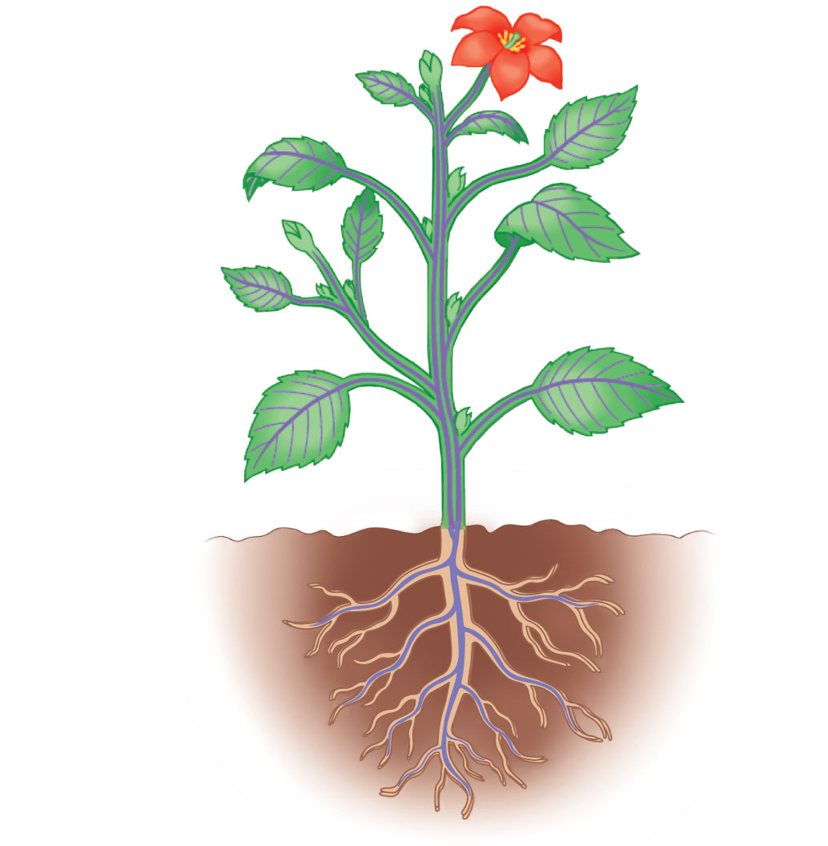
Figure 28.3
Reproductive shoot (flower)
Apical bud
Node
Internode
Apical bud
Shoot
system
Vegetative shoot
Leaf
Blade
Petiole
Axillary bud
Stem
Taproot
Lateral
(branch)
roots
Root
system
© 2016 Pearson Education, Inc.
Notes:
Figure 28.3 An overview of a flowering plant

Slide 6
Roots rely on sugar produced by photosynthesis in the shoot system
Shoots rely on water and minerals absorbed by the root system
The root system and the shoot system are connected by vascular tissue
Notes:
6

Slide 7
Roots
A root is an organ with important functions
Anchoring the plant
Absorbing minerals and water
Storing carbohydrates
Notes:
7

Slide 8
Tall, erect plants with large shoot masses have a taproot system, which consists of
A taproot, the main vertical root
Lateral roots branching off the taproot
Small or trailing plants have a fibrous root system, which consists of
Adventitious roots that arise from stems
Lateral roots that arise from the adventitious roots and form their own lateral roots
Notes:
8

Slide 9
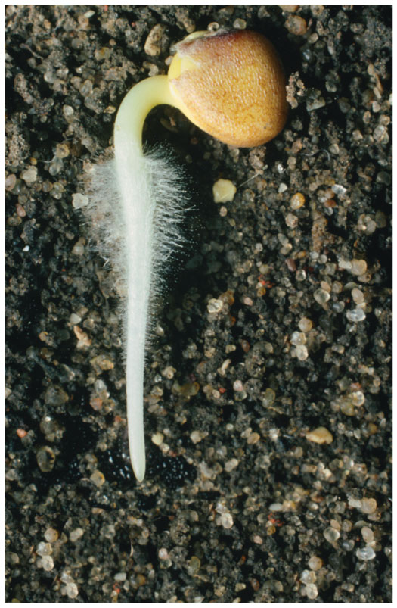
In most plants, absorption of water and minerals occurs through the root hairs, thin extensions of epidermal cells that increase surface area
Figure 28.4
Notes:
9

Slide 10
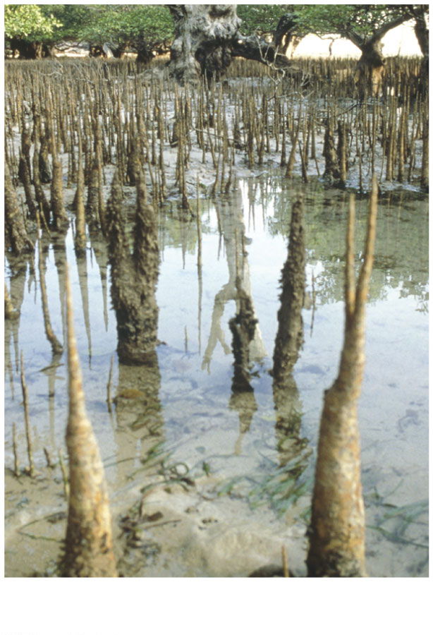
Figure 28.5-1
▲ Pneumatophores
© 2016 Pearson Education, Inc.
Notes:
Figure 28.5-1 Evolutionary adaptations of roots (part 1: pneumatophores)

Slide 11
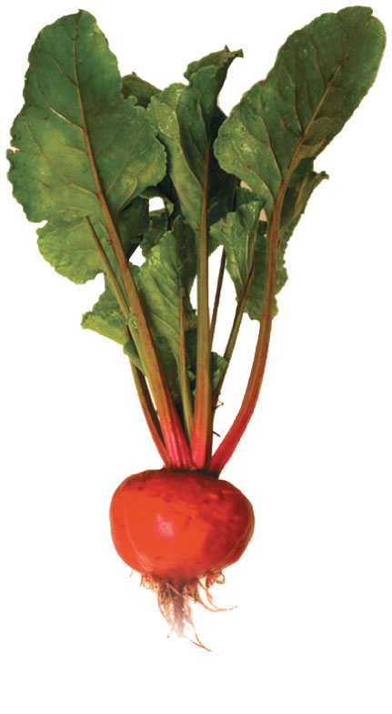
Figure 28.5-2
▲ Storage roots
© 2016 Pearson Education, Inc.
Notes:
Figure 28.5-2 Evolutionary adaptations of roots (part 2: storage roots)

Slide 12
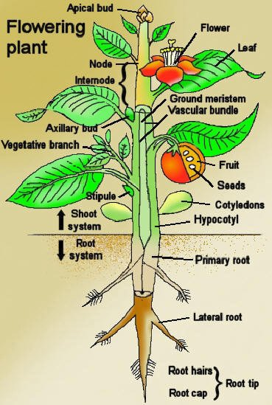
Stems
A stem is an organ that
Provides support for
leaves
Transport between
roots and leaves
Notes:
12

Slide 13
Leaves
The leaf is the main photosynthetic organ of most vascular plants
Leaves have other functions including exchanging gases with the environment, defense and dissipation of heat
Leaves vary in form, but generally consist of a flattened blade and a stalk called the petiole, which joins the leaf to the stem
Notes:
13

Slide 14
Some plant species have evolved modified leaves that serve various functions
Notes:
14

Slide 15
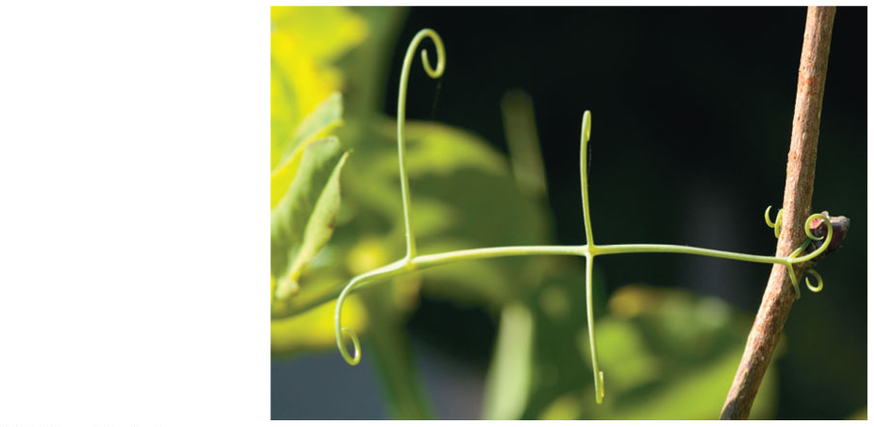
Figure 28.7-1
Tendrils
Clings to a support;
ex: pea plants
© 2016 Pearson Education, Inc.
Notes:
Figure 28.7-1 Evolutionary adaptations of leaves (part 1: tendrils)

Slide 16
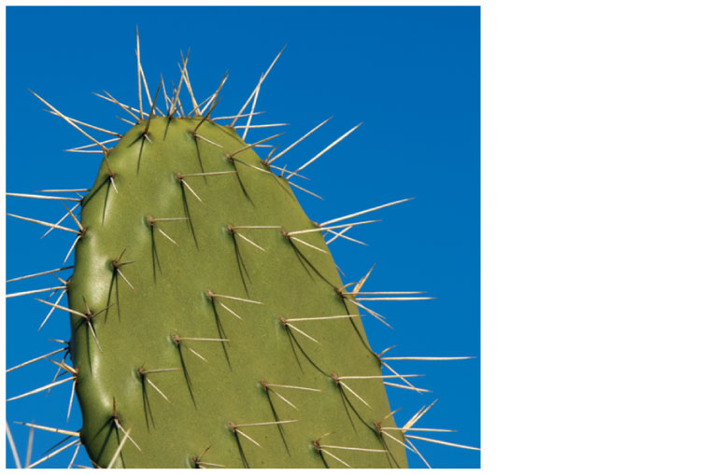
Figure 28.7-2
Spines
Reduced leaves in
succulents to prevent
water loss and protect; photosynthesis
occurs in stem
© 2016 Pearson Education, Inc.
Notes:
Figure 28.7-2 Evolutionary adaptations of leaves (part 2: spines)

Slide 17
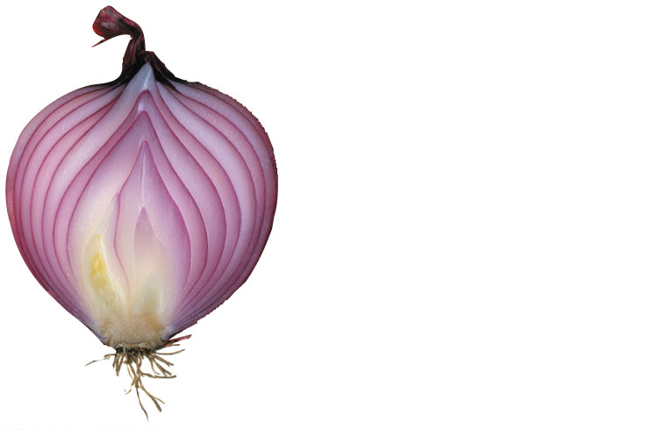
Figure 28.7-3
Storage leaves
Bulbs have a short
underground stem and modified leaves that store food
Storage leaves
Stem
© 2016 Pearson Education, Inc.
Notes:
Figure 28.7-3 Evolutionary adaptations of leaves (part 3: storage leaves)

Slide 18
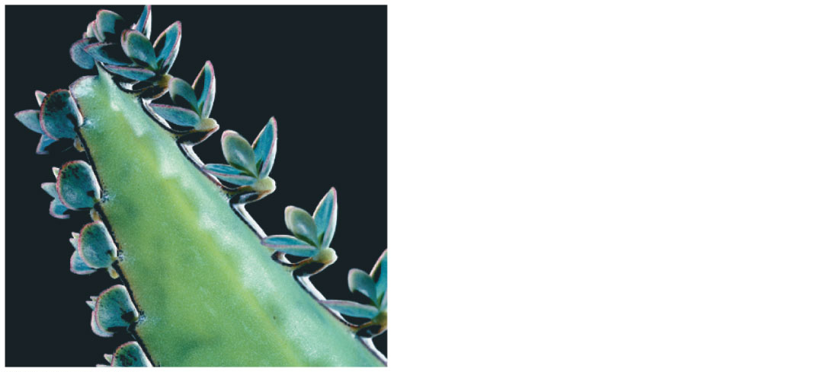
Figure 28.7-4
Reproductive leaves
Plantlet
Produce plantlets which fall off the leaf and take root in the soil
© 2016 Pearson Education, Inc.
Notes:
Figure 28.7-4 Evolutionary adaptations of leaves (part 4: reproductive leaves)

Slide 19
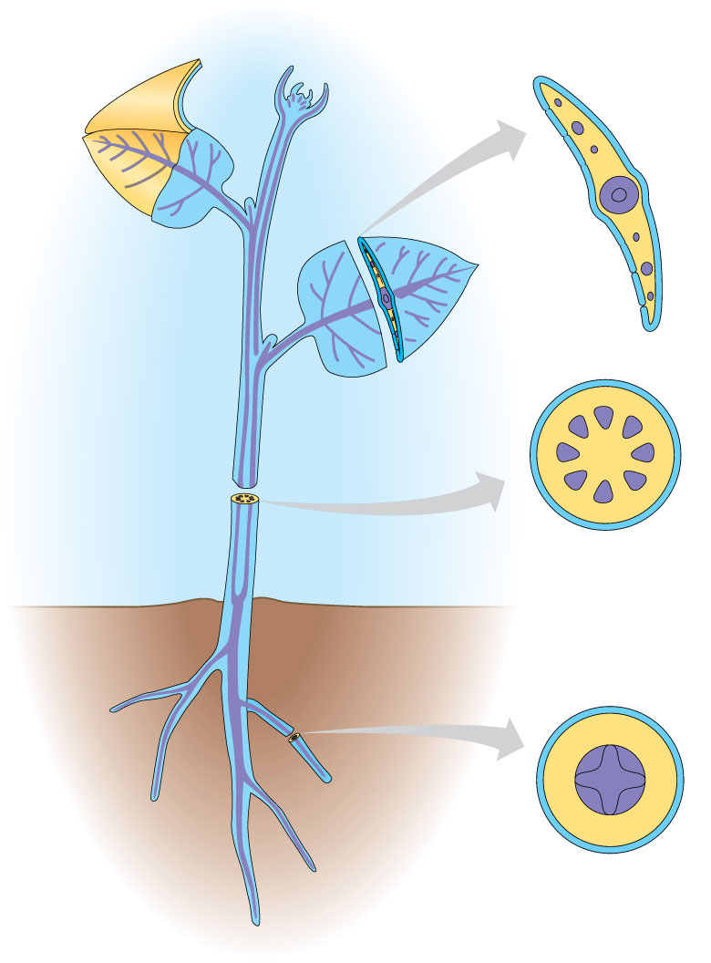
Dermal, Vascular, and Ground Tissue Systems
Each plant organ is composed of three tissue systems: dermal, vascular, and ground tissue
Each tissue system is continuous throughout the plant
Dermal
tissue
Ground
tissue
Vascular
tissue
Notes:
19

Slide 20
The dermal tissue system is the outer protective covering
In leaves and most stems, a waxy coating called the cuticle helps prevent water loss from the epidermis
Notes:
20

Slide 21
The vascular tissue system facilitates transport of materials through the plant and provides support
The two vascular tissues are xylem and phloem
Xylem conducts water and dissolved minerals upward from roots into the shoots
Phloem transports sugars from where they are made to where they are needed
Notes:
21

Slide 22
Tissues that are neither dermal nor vascular are part of the ground tissue system
Ground tissue internal to the vascular tissue is pith; ground tissue external to the vascular tissue is cortex
Ground tissue may include cells specialized for photosynthesis, short-distance transport, storage, or support
Notes:
22

Slide 23
Concept 28.2: Different meristems generate new cells for primary and secondary growth
A plant can grow throughout its life; this is called indeterminate growth
Indeterminate growth is enabled by meristems, which are perpetually undifferentiated tissues
Some plant organs cease to grow at a certain size; this is called determinate growth
Ex: leaves, thorns, flowers
Notes:
23

Slide 24
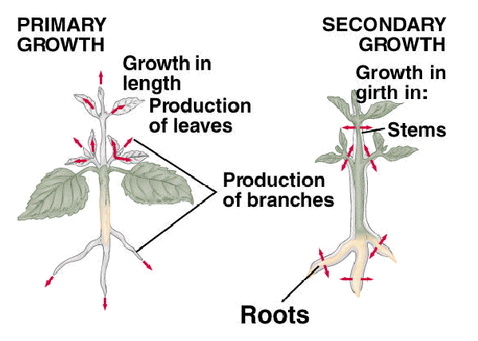
In woody plants, primary growth extends the shoots and secondary growth increases the diameter of previously formed parts
Notes:
24

Slide 25
Concept 28.3: Primary growth lengthens roots and shoots
Primary growth arises from the apical meristems and produces parts of the root and shoot systems
Notes:
25

Slide 26
Primary Growth of Roots
The root tip is covered by a root cap, which protects the apical meristem as the root pushes through soil
Growth occurs just behind the root tip, in three zones of cells
Zone of cell division- new root cells produced
Zone of elongation- most growth occurs as root cells elongate (sometimes 10X original length)
Zone of differentiation, or maturation- cells complete differentiation and become distinct cell types
Notes:
26

Slide 27
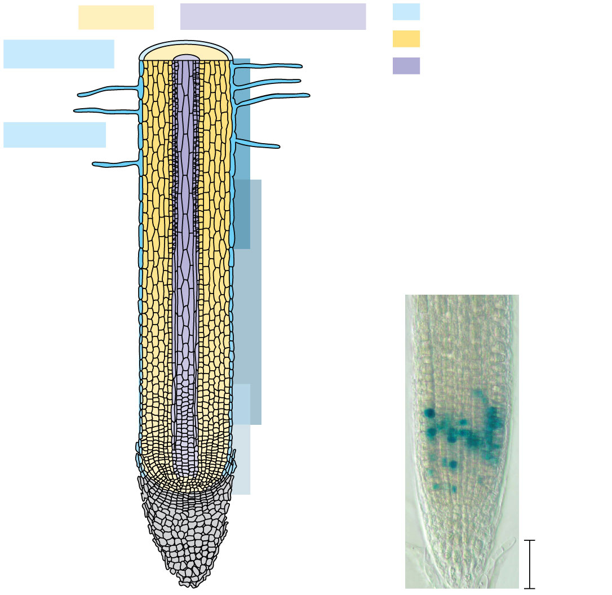
Figure 28.13
Cortex
Vascular cylinder
Dermal
Ground
Epidermis
Vascular
Zone of
differentiation
Root hair
Zone of
elongation
Zone of cell
division
(including
root apical
meristem)
Mitotic
cells
100 𝛍m
© 2016 Pearson Education, Inc.
Root cap
Notes:
Figure 28.13 Primary growth of a typical eudicot root

Slide 28
Video: Root Time Lapse
Notes:
28

Slide 29
Tissue Organization of Leaves
The epidermis of leaves is interrupted by stomata, pores that allow gas exchange between the air and the photosynthetic cells of the leaf
Each stomatal pore is flanked by two guard cells, which regulate its opening and closing
The ground tissue in a leaf, called mesophyll, is composed of parenchyma cells sandwiched between the upper and lower epidermis
Notes:
29

Slide 30
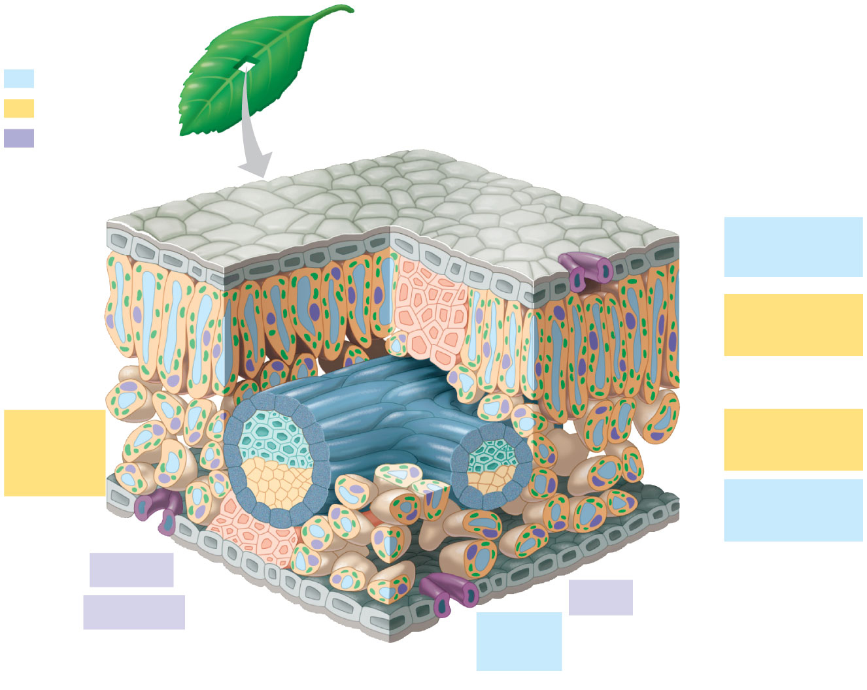
Figure 28.17-1
Dermal
# 7 & 12
Ground
Cuticle
Sclerenchyma
fibers
Vascular
# 8 & 13
Stoma
Upper
epidermis
#2
Palisade
mesophyll
#3
Bundle-
sheath
cell
Spongy
mesophyll
#4
Lower
epidermis
#6
Xylem
Cuticle
Vein
#5
Phloem
Guard
cells
(a) Cutaway drawing of leaf tissues
# 1 & 9
© 2016 Pearson Education, Inc.
Notes:
Figure 28.17-1 Leaf anatomy (part 1: cutaway drawing of leaf tissues)

Slide 31
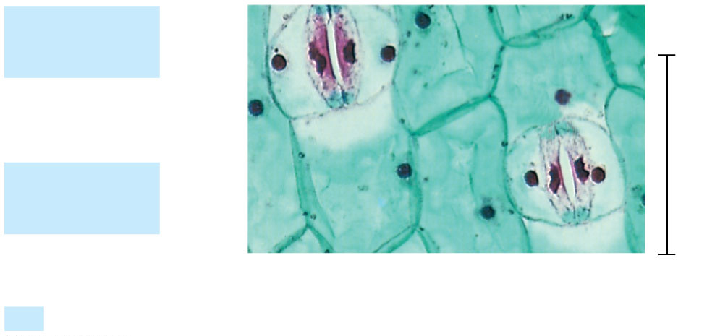
Figure 28.17-2
Guard
cells
Stomatal
pore
50 𝛍m
Epidermal
cell
(b) Surface view of a spiderwort (Tradescantia) leaf (LM)
Dermal
© 2016 Pearson Education, Inc.
Notes:
Figure 28.17-2 Leaf anatomy (part 2: surface view of a spiderwort (Tradescantia) leaf (LM))

Slide 32
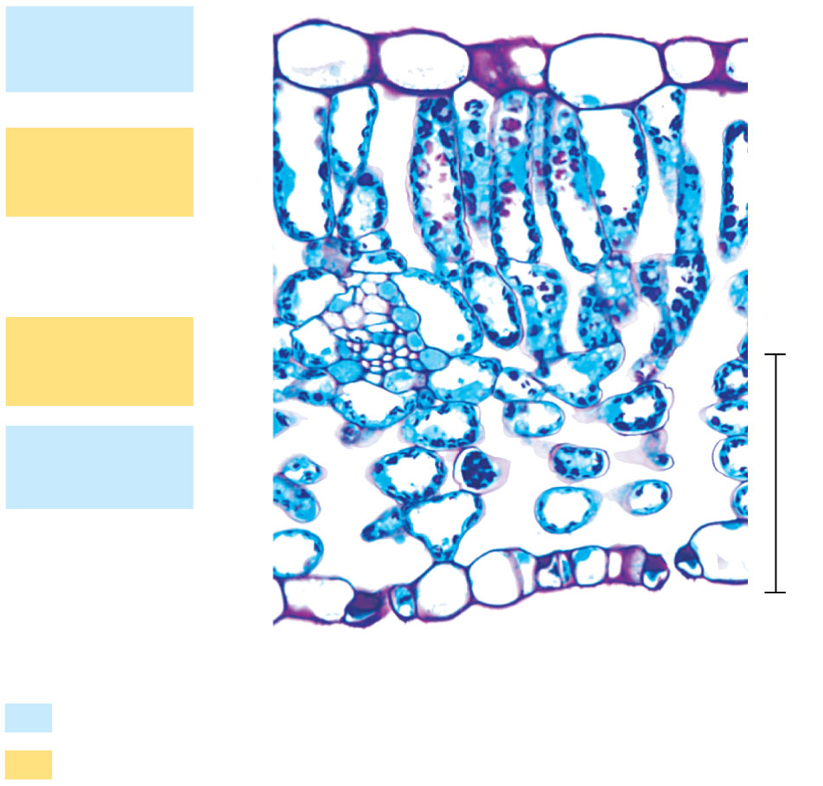
Figure 28.17-3
Upper
epidermis
Palisade
mesophyll
Spongy
mesophyll
Lower
epidermis
100 𝛍m
Vein
Air spaces
Guard cells
#10
Dermal
Ground
(c) Cross section of a lilac (Syringa) leaf (LM)
© 2016 Pearson Education, Inc.
Notes:
Figure 28.17-3 Leaf anatomy (part 3: cross section of a lilac (Syringa) leaf (LM))

Slide 33
The mesophyll of eudicots has two layers
The palisade mesophyll in the upper part of the leaf consists of elongated cells for photosynthesis
The spongy mesophyll in the lower part of the leaf consists of loosely arranged cells for gas exchange
Notes:
33

Slide 34
The vascular tissue of each leaf is continuous with the vascular tissue of the stem
Veins are the leaf’s vascular bundles, which function in fluid transport and provide structure to the leaf
Each vein in a leaf is enclosed by a protective bundle sheath
Notes:
34

Slide 35
Bark consists of all the tissues external to the vascular cambium, including secondary phloem and periderm
Lenticels in the periderm allow for gas exchange between living stem or root cells and the outside air
The function of bark is protection; it acts as a physical barrier reducing water loss, protecting from physical damage and pathogens/insects
Notes:
35

